Slide 1
Quality Center Reverse KT
Infosys 2019
17^{th July, 2019 Wednesday}

Slide 2
Agenda
Introduction
Architecture Overview
Application Workflow
Application Overview
Quality Center
→ Application URL/ Login View
→ Quality Center Home Page
→ Application Functionality
Stakeholders Information
Most Common Issues
Support Contacts

Slide 3
Introduction
Quality Center Or HP ALM (Application Life Cycle Management)
It is a test management tool offered by Micro Focus
HP ALM that supports various phases of the software development life cycle
It is a web based tool that helps organizations to manage the application lifecycle
→ Project Planning
→ Project tracking
→ Test Resources, Test Plan
→ Test Lab, Test Runs
→ Defects management and Dashboard view

Slide 4



Application Workflow
End User
ICT Service Desk
Support Team
Posti user
ICT Service Desk (Posti)
Sogeti FI

Slide 5
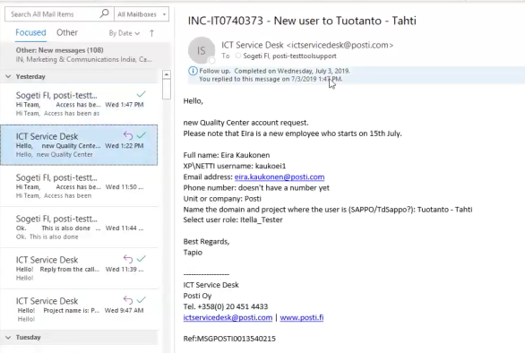
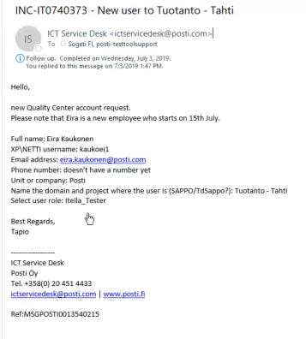
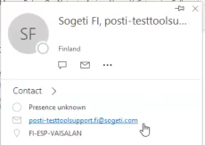
Application Workflow

Slide 6


Architeture Overview
End User
Quality Center (HP ALM)
https protocal
https://qc.posti.com/qcbin/start_a.jsp
Site to Site VPN connectivity
QC server (Posti)
One share Azure Cloud

Slide 7
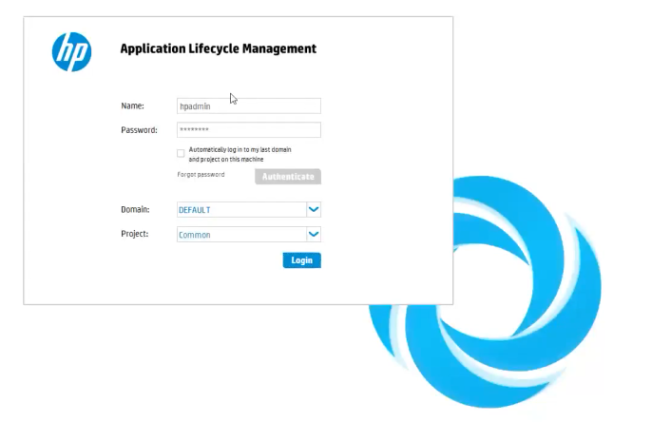
Application Overview: Quality Center
Application URL:
→ https://qc.posti.com/qcbin/start_a.jsp
Login View:

Slide 8
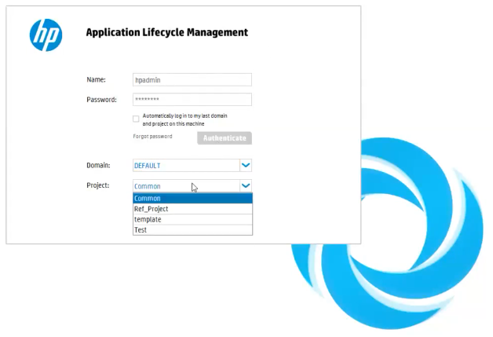
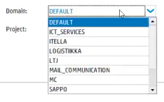

Slide 9
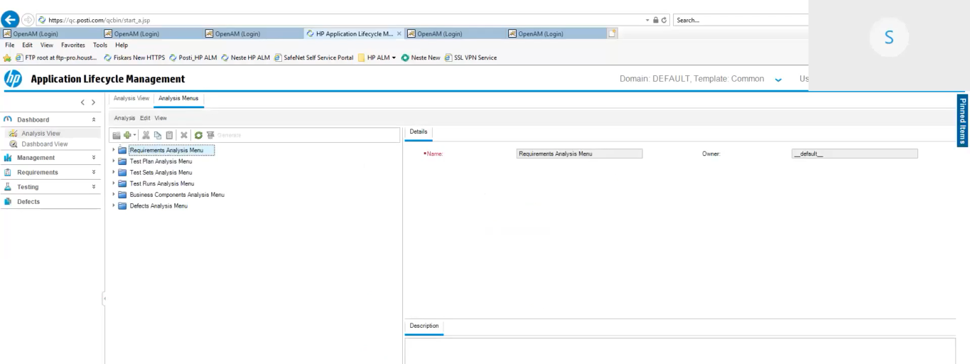
HP ALM Home Page: Landing Page

Slide 10
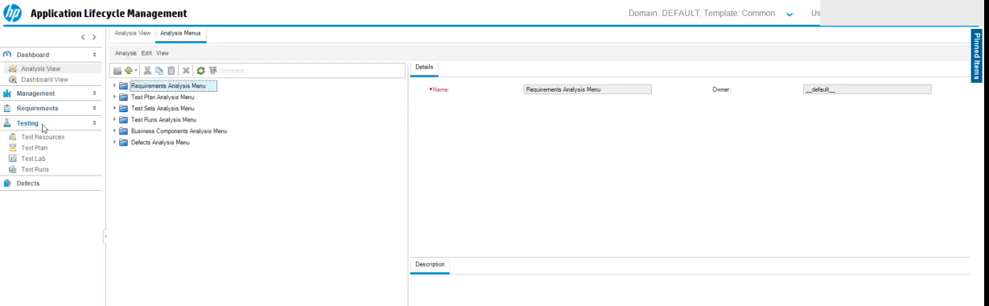
HP ALM → Testing View

Slide 11
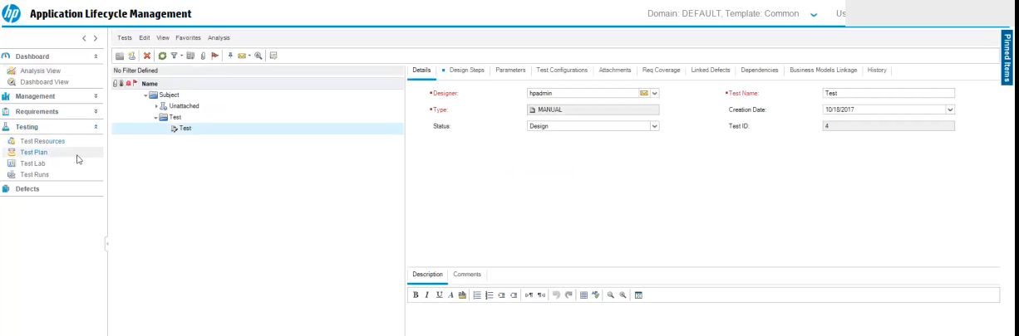
HP ALM → Testing → Test Plan View

Slide 12
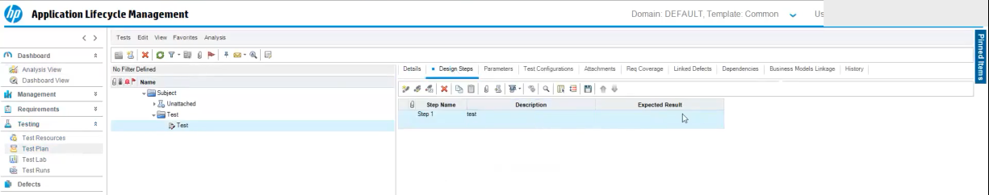
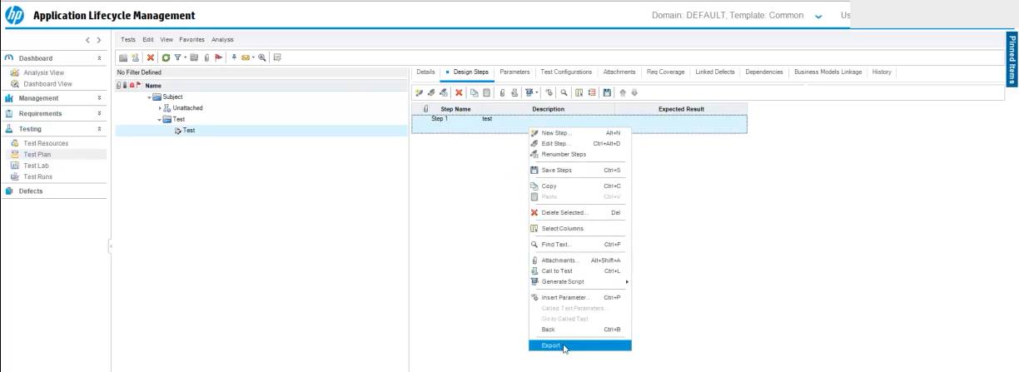
HP ALM → Testing → Test Plan View

Slide 13
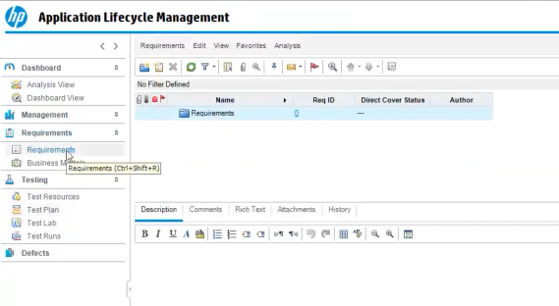
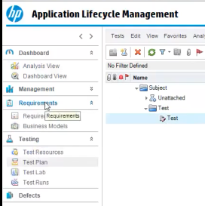
HP ALM → Requirements Dashboard

Slide 14
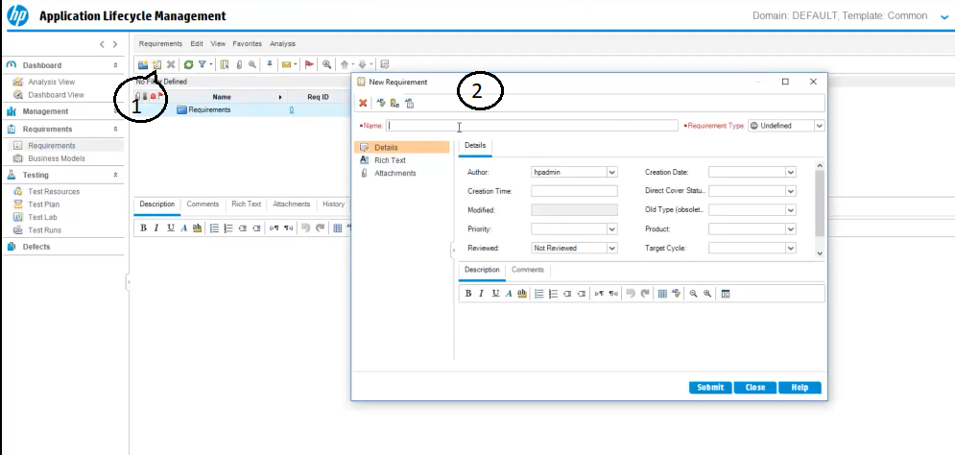
HP ALM → Requirements Dashboard → New Requirement

Slide 15
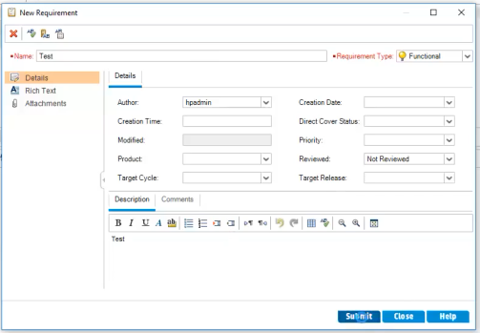
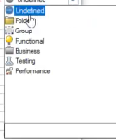
HP ALM → Requirements Dashboard → New Requirements
2
3

Slide 16
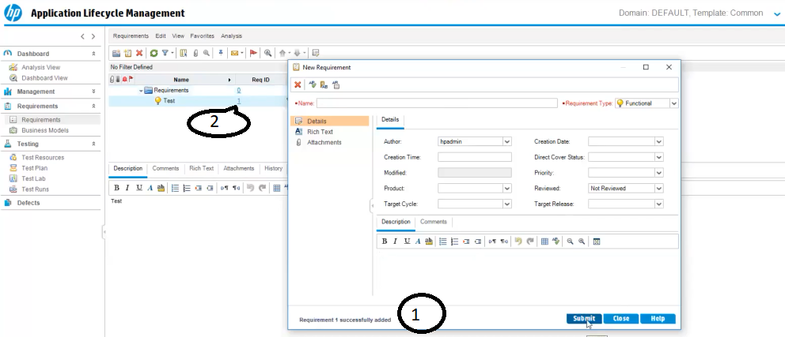
HP ALM → Requirements Dashboard → New Requirements → Created

Slide 17
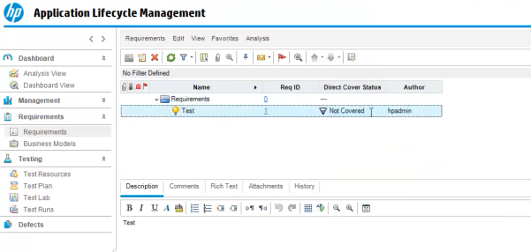
HP ALM → Requirements Dashboard → New Requirements → Requirement View
One Requirement Created but Direct Cover status is “ Not Covered”

Slide 18
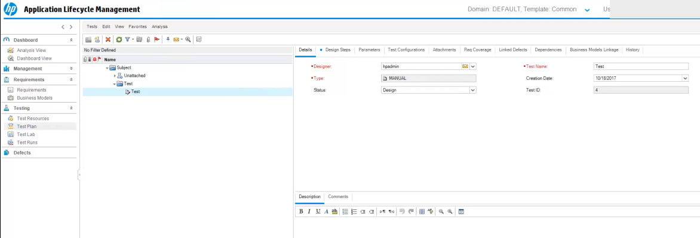
HP ALM → Test Plan → Details

Slide 19
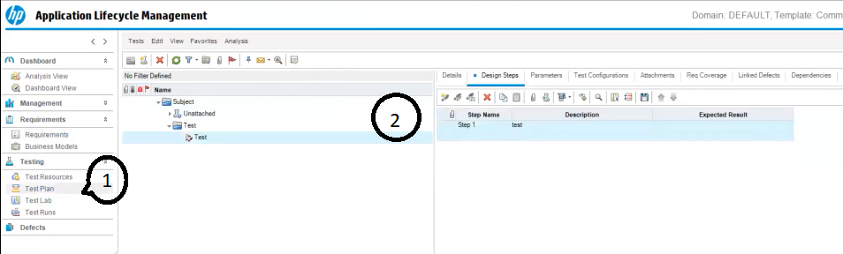
HP ALM → Test Plan → Design Steps

Slide 20
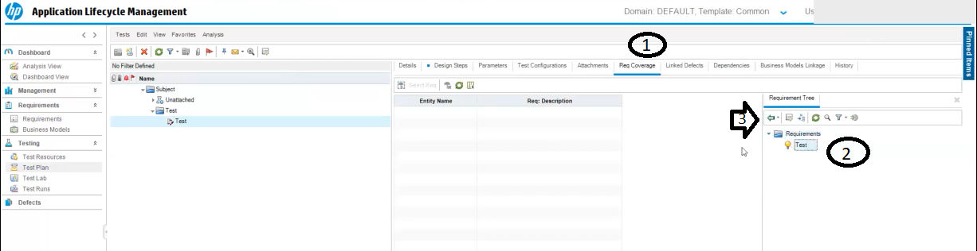
HP ALM → Test Plan → Req Coverage (1)
Click ”Select Req”

Slide 21
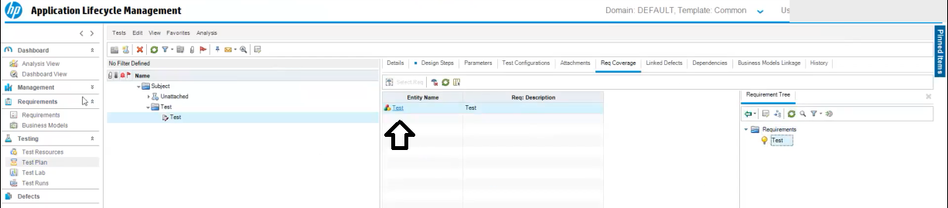
HP ALM → Test Plan → Req Coverage (2)

Slide 22
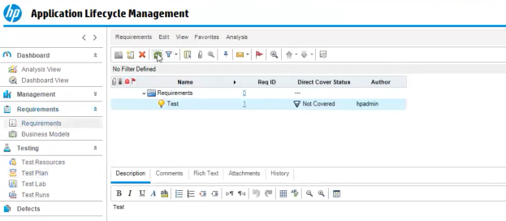
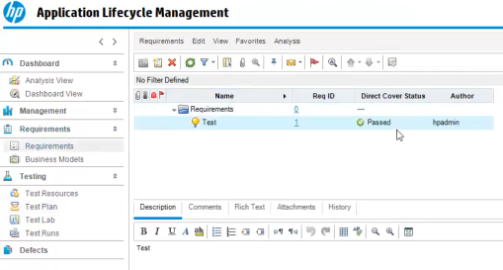
HP ALM → Test Plan → Req Coverage → Status
Before Req Coverage
After Req Coverage

Slide 23
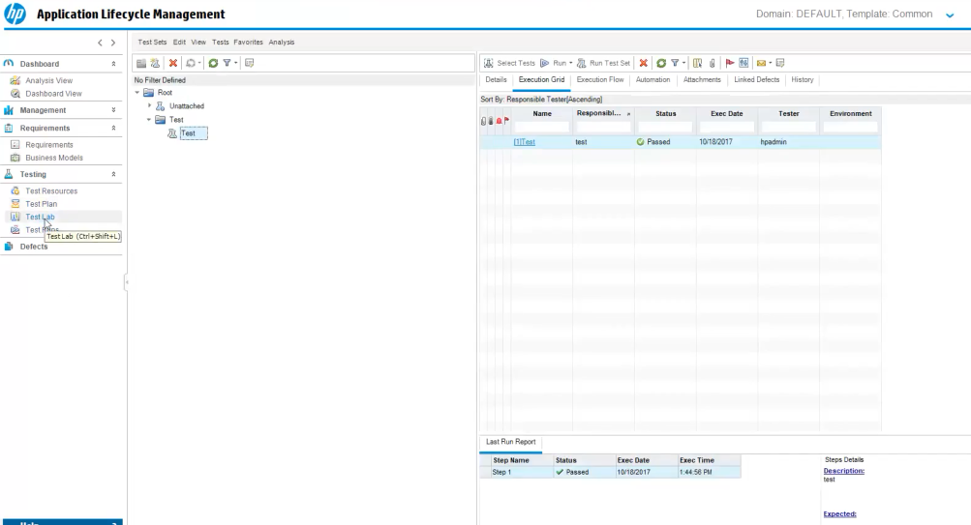
HP ALM → Test Lab View

Slide 24
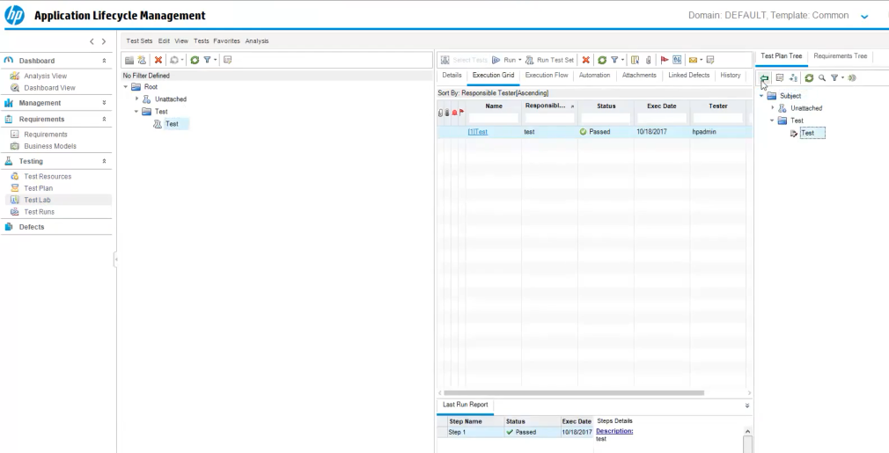
HP ALM → Test Lab → All Test Cases

Slide 25
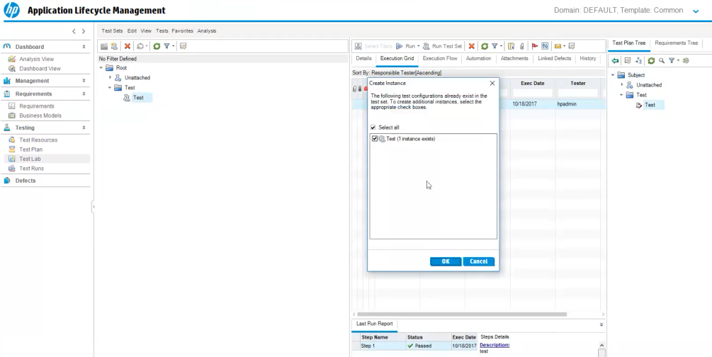
HP ALM → Test Lab → Create new test case(Existing test plan)

Slide 26
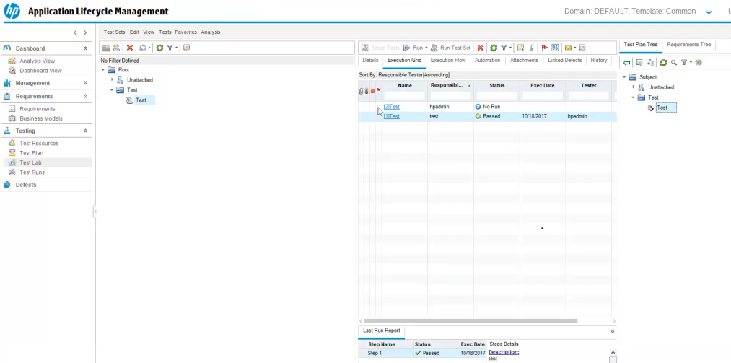
HP ALM → Test Lab → Test Plan Created

Slide 27
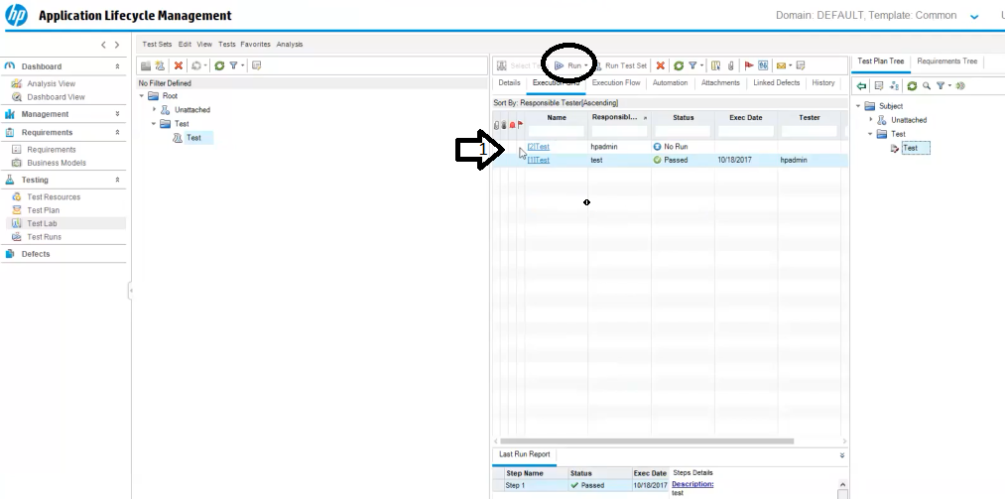
HP ALM → Test Lab → Test Plan → Run

Slide 28
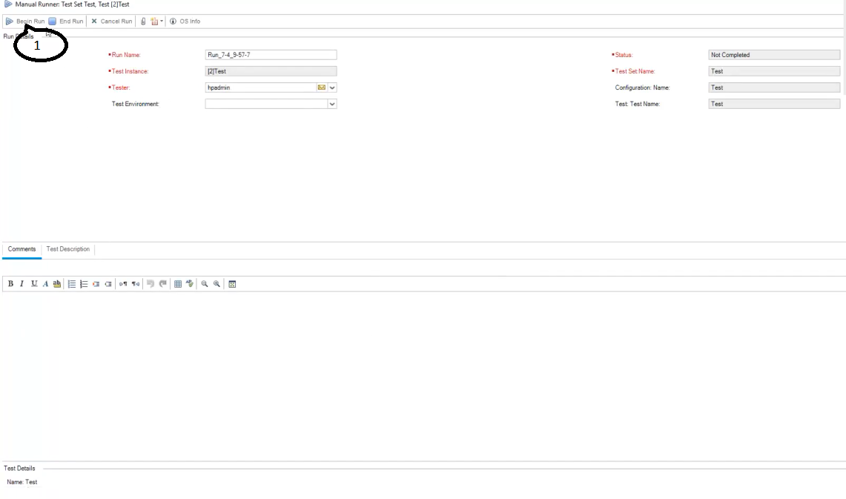
HP ALM → Test Lab → Test Plan → Test Run Details

Slide 29
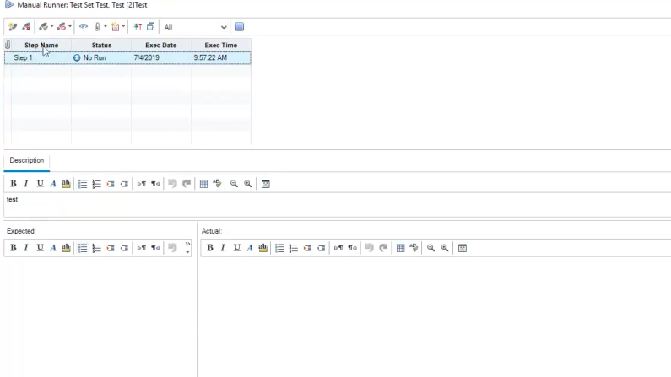
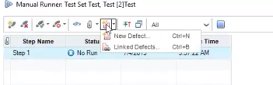
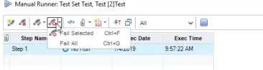
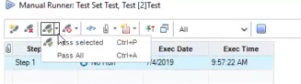
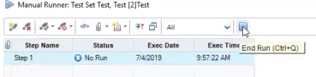
HP ALM → Test Lab → Test Plan → Test Run Details
1
2
3
4

Slide 30
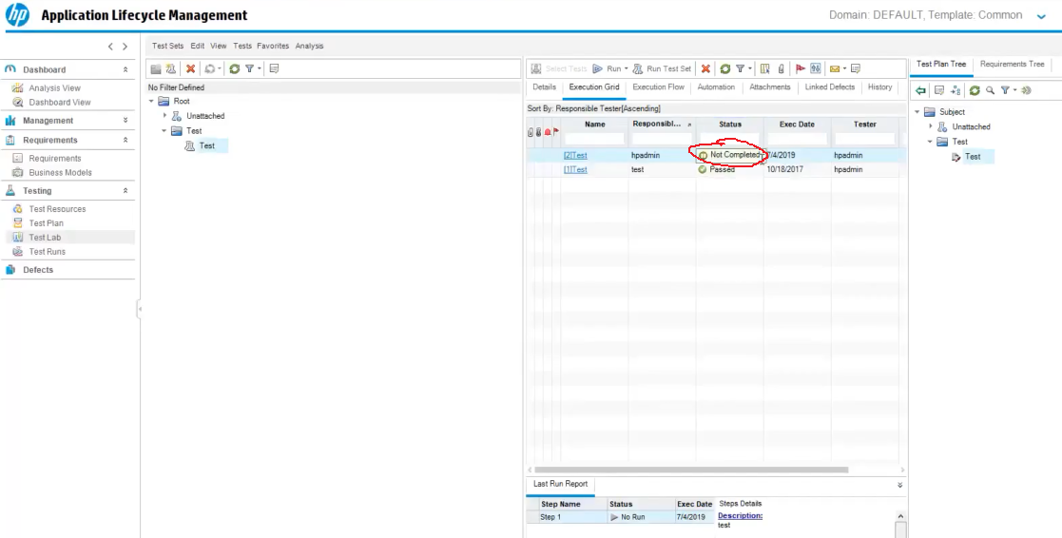
HP ALM → Test Lab → Test Plan → Test Run After View

Slide 31
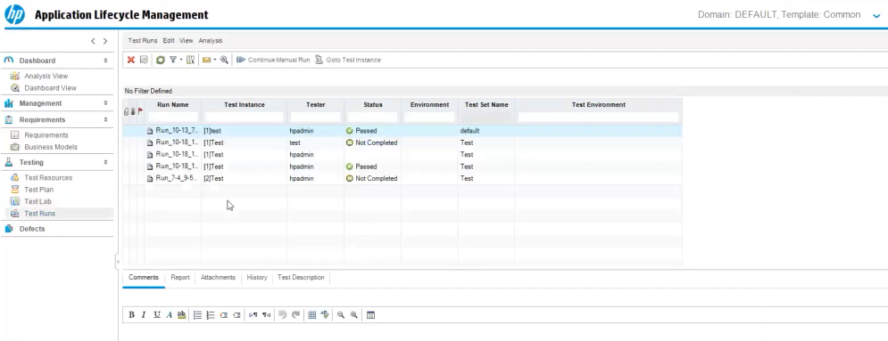
HP ALM → Test Runs View

Slide 32
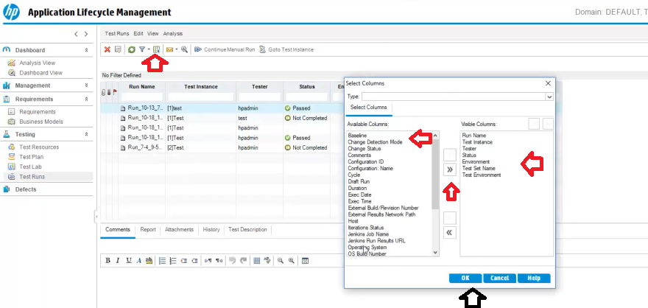
HP ALM → Test Runs View → Add new section column

Slide 33
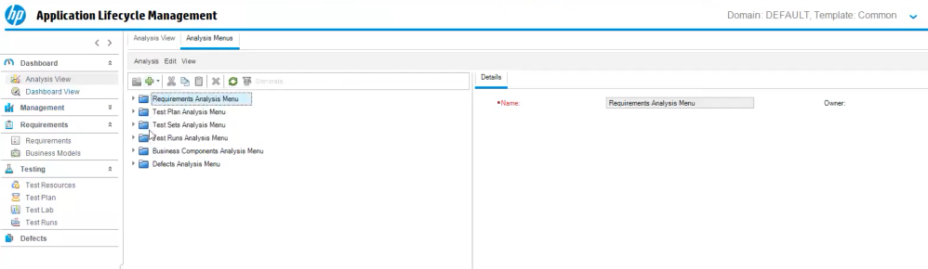
HP ALM → Dashboard → Analysis View

Slide 34
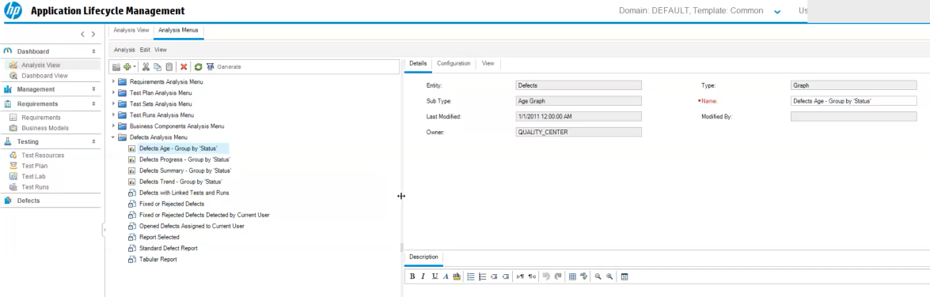
HP ALM → Dashboard → Analysis View → Defects Analysis Menu

Slide 35
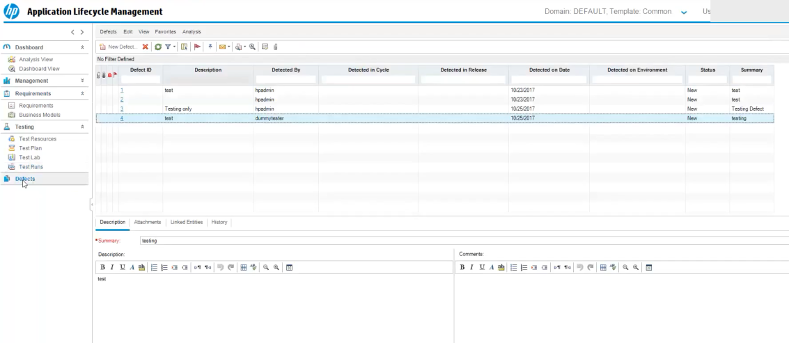
HP ALM → Defects View

Slide 36
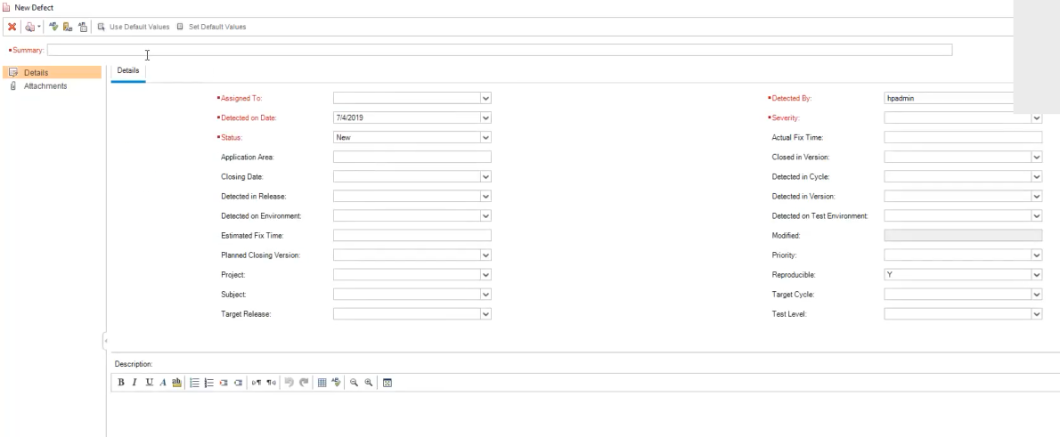
HP ALM → Defects View → New Defect

Slide 37
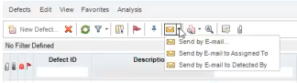
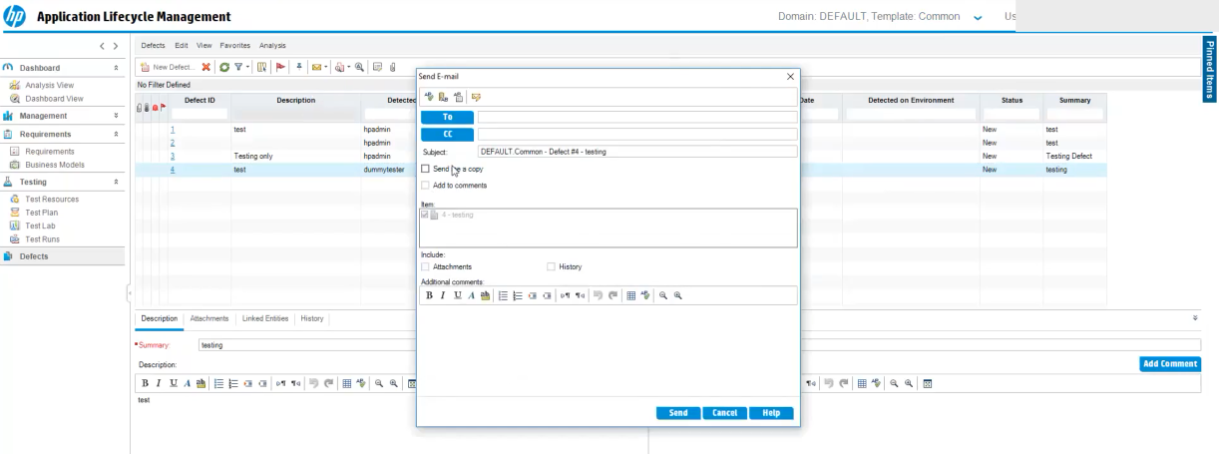
HP ALM → Defects View → Defect Mail Trigger

Slide 38
Stakeholders Information
The various stakeholders involved in a typical project are –
→ Tester
Developer
Test Lead
→ Project Managers
→ Product Owners

Slide 39
Most Common Issues
Request for access the Quality Center Application
→ Create a new Quality Center account request
Unable to access the view tabs in Quality Center(HP ALM)
e.g. → Dashboard view
→ Requirementss
→ Test plan and etc.
Customisation Requests in Quality Center
Access and Errors in Quality Center

Slide 40
Support Contacts
ICT Service Desk from Posti
→ ictservicedesk@posti.com
Sogeti FI from Sogeti Oy
→ posti-testtoolsupport.fi@sogeti.com

Slide 41
☺
Thank You

